Slide 1
Web designing project
Name – Abhinav Anand
Topic – Cards website
Submitted to – Arpit saxena sir.
Technology used – HTML,CSS

Slide 2
What is web designing
Web designing is the process of planning, conceptualizing, and implementing the plan for designing a website in a way that is functional and offers a good user experience.

Slide 3
About HTML
HTML is a markup language used by the browser to manipulate text, images, and other content, in order to display it in the required format. HTML was created by Tim Berners-Lee in 1991. The first-ever version of HTML was HTML 1.0, but the first standard version was HTML 2.0, published in 1995.

Slide 4
basic structure of HTML code.
<!DOCTYPE html>
<html>
<head>
<meta charset="UTF-8">
<meta name="viewport" content="width=device-width, initial-scale=1.0">
<!--The above meta characteristics make a website compatible with different devices. -->
<title>Demo Web Page</title>
</head>
<body>
<h1>
</h1>
<p>A computer science portal f</p>
</body>
</html>

Slide 5
What is css
CSS stands for Cascading Style Sheets
CSS describes how HTML elements are to be displayed on screen, paper, or in other media
CSS saves a lot of work. It can control the layout of multiple web pages all at once
External stylesheets are stored in CSS files

Slide 6
CSS example
body { background-color: lightblue; } h1 { color: white; text-align: center; } p { font-family: verdana; font-size: 20px; }

Slide 7
About Cards website
In this website, I have designed a website for taking orders of cards.
I have used HTML and CSS for designing of the website.
Anyone wants to make cards for any thing can come to this website and book their slots.
By doing some simple steps any one can book their slots after completing payment.

Slide 8
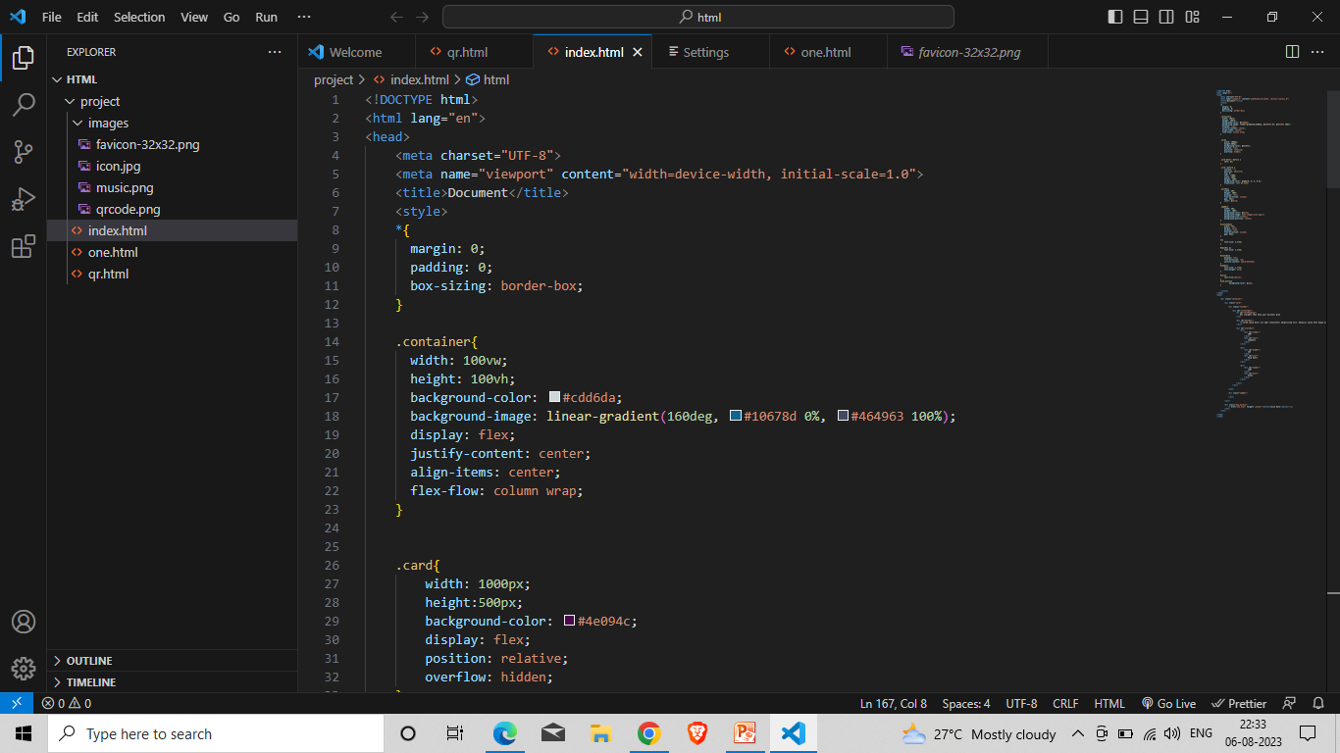
Screenshots

Slide 9
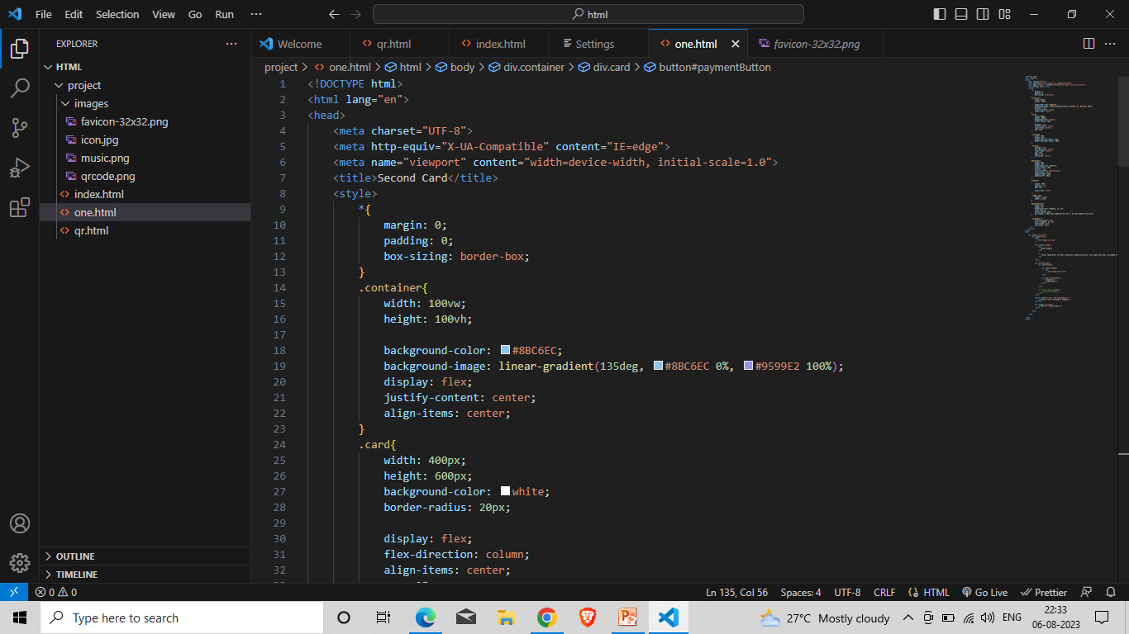

Slide 10
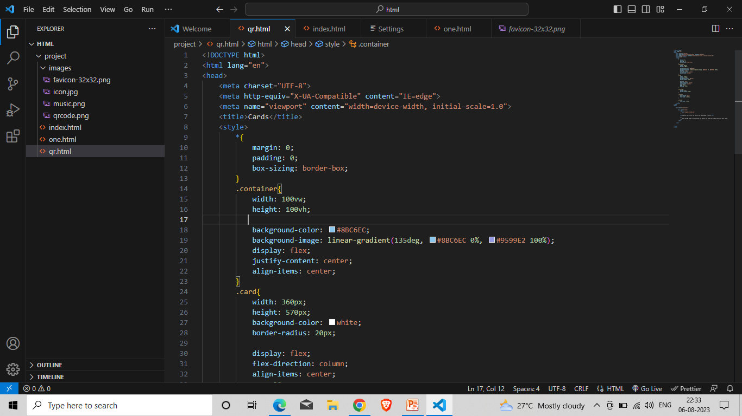

Slide 11
Thank you

